Slide 1

Phone Shopping Network Ver 1.0
Team Member(s): Khaja Mohammed Dewan Moksedul Product Owner(s): Charles Green Mohsen Taheri
Instructor: Masoud Sadjadi School of Computing and Information Sciences Florida International University
Advanced Software Engineering Final Presentation
Fall 2016
Notes:
7 seconds.
Greet your audience, thank them for attending your presentation, introduce yourself, introduce your project, introduce your team members, and quickly indicate what each of you did in a high-level manner, and put more emphasis on your part/contribution.

Slide 2
Project definition
Phone Shopping Network Ver 1.0 is a private android application for the users of the phones that are part of the Lifeline "Obamaphone" program.
It provides users with Online shopping facility which allows user to register an account and purchase items, which are displayed on their mobile screens using ADUPS FOTA(Firmware Over-The-Air) technology.
These phones are all in the hands of low income families that could benefit from great deals on necessities as well as help in establishing credit.
Notes:
10 seconds.
Introduce the problem that the whole project (in all versions) tackles with GIF or screenshot.

Slide 3
Project definition
A user opens the application from his mobile and is prompted with a Terms and Condition page where the user accepts or rejects the terms and conditions of the application
The system checks if the user is already registered in the system or it is a new user, if a new user then the registration page is shown where the user register into the application
Finally the product page is shown to the user with the list of products for them.
Notes:
20 seconds.
Introduce the problem that the your project (in new version) tackles with GIF or screenshot.

Slide 4
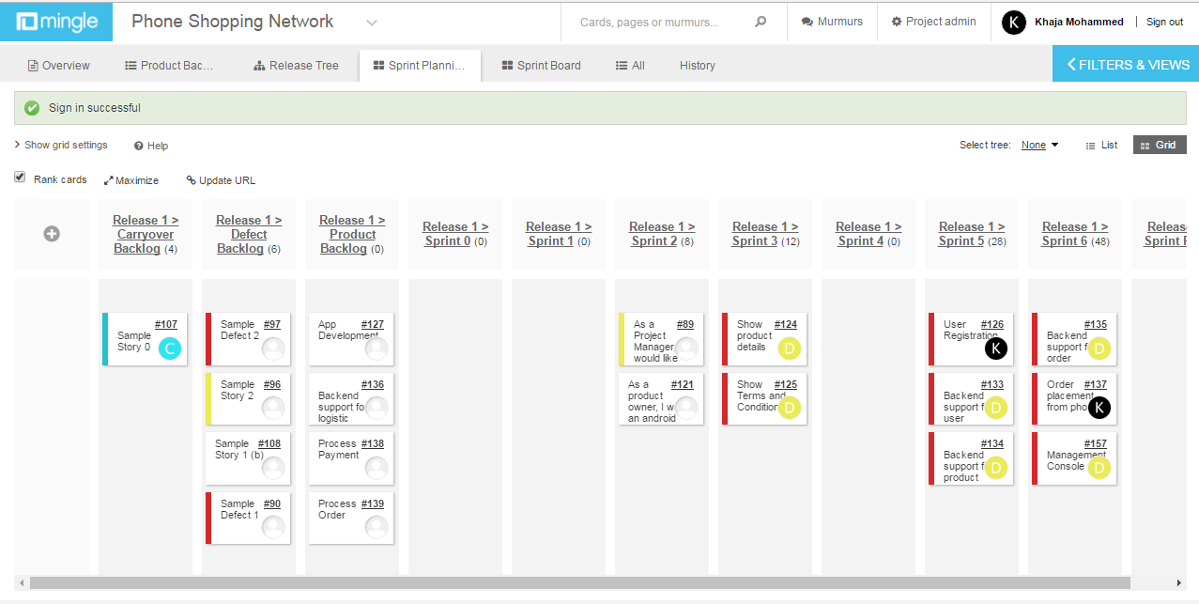
Project Management
Figure 1: Sprint Planning

Slide 5
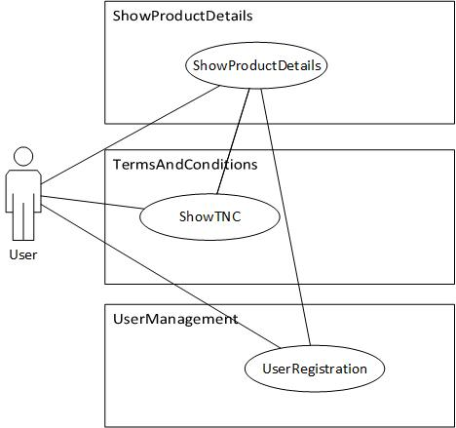
Requirements: Use Cases
1
Figure-UCD#125: Use case diagram of Terms and Condition & Figure-UCD#124: Use case diagram of Show Product Details
Notes:
5 seconds
Show the Use Case Diagram for the whole project. Highlight your use cases.

Slide 6
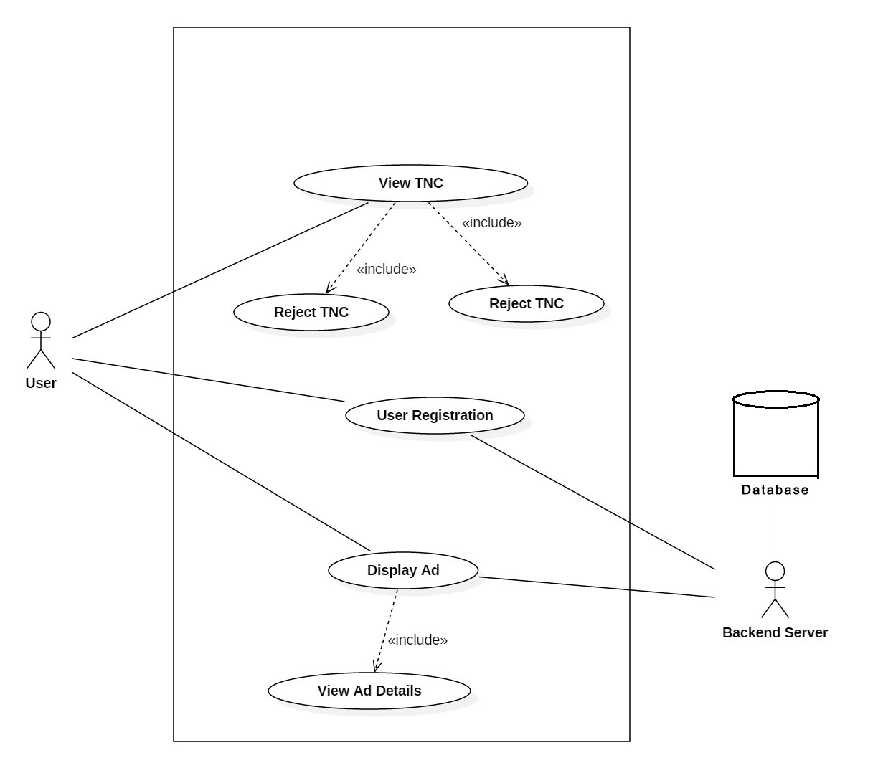
Requirements: Use Cases
2
Figure-UCD#126: Use case diagram of user registration

Slide 7
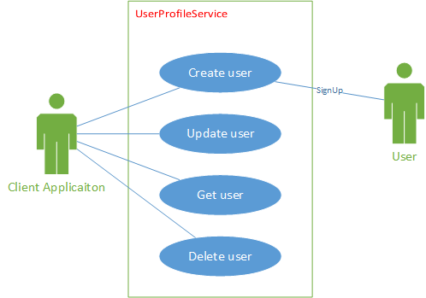
Requirements: Use Cases
3
Figure-UCD#133: Use case diagram of user profile subsystem

Slide 8
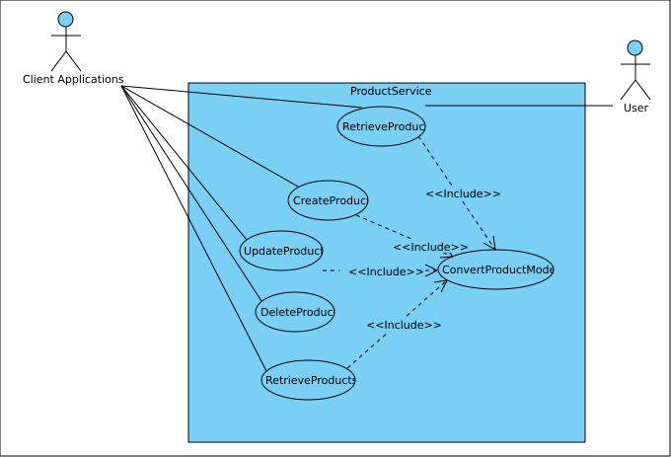
Requirements: Use Cases
4
Figure-UCD#134 Use case diagram for product service management

Slide 9
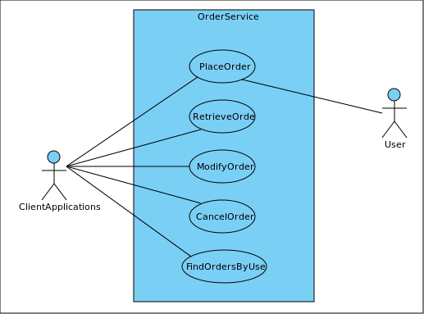
Requirements: Use Cases
Figure-UCD#135: Use case diagram of the OrderService subsystem

Slide 10
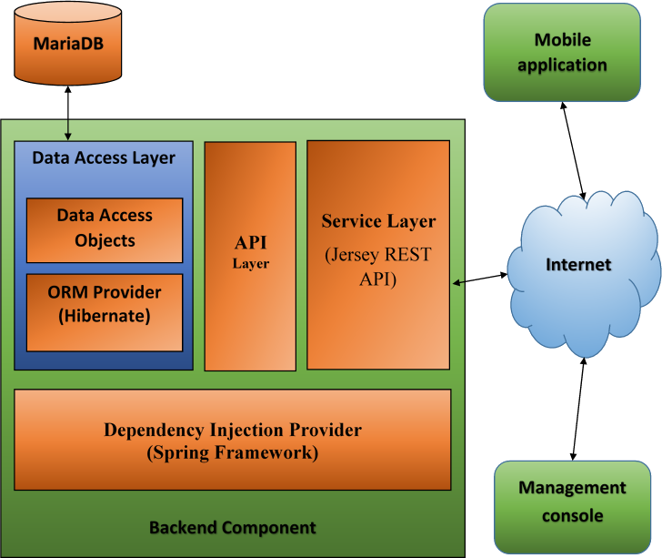
System Design: Architecture
Figure-UCD#135: Use case diagram of the OrderService subsystem
Notes:
20 seconds
System design: Highlight the parts that you contributed to them.
1. System decomposition; identify the architecture patterns used
2. System deployment – h/w and s/w requirements

Slide 11
System Design: Architecture
Server Component
The server side component is further divided into several layers.
Service Layer: It is the boundary or interface to other systems. It is composed of several RESTful web service endpoints. This layer takes advantage of another layer which is the core Business Logic Layer.
Business Logic Layer (BLL): This layer consists of some objects those manage the functionalities provided around the main concepts of the whole system. This Business Logic Layer is basically implements an API layer which defines the provided functionalities of the system along with naive implementations. The Business Logic Layer also utilizes the Data Access Layer (DAL).

Slide 12
System Design: Architecture
Data Access layer (DAL): The DAL maintains the communication to and from the database and takes care of the transaction management. The DAL consists of some Data Access Objects (DAOs) and Relational Entities. These objects are designed with the Object Relational Mapping (ORM) service provided by Hibernate following the standard Java Persistence API (JPA).
Transaction Manager: All of these layers and components are wrapped around by a transaction management facility provided by Spring framework. This facility will ensure graceful handling of runtime errors and ensures that no data is incorrectly persisted or presented in such cases.

Slide 13
System Design: Architecture
Dependency Injection (DI): Moreover the Spring framework binds all these layers and components together using DI.
Persistent storage: MariaDB is used as the relational database for the system.

Slide 14
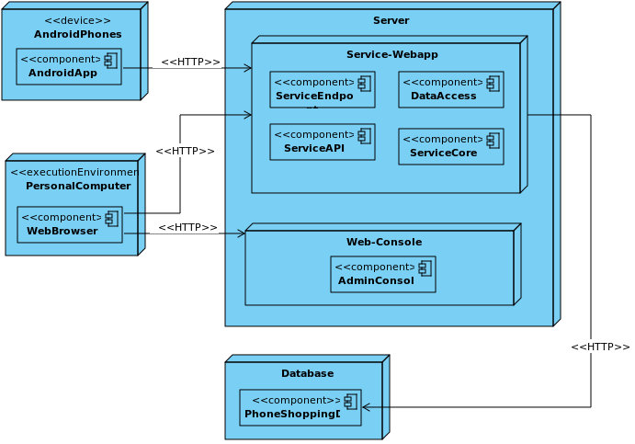
System Design: Deployment Diagram

Slide 15
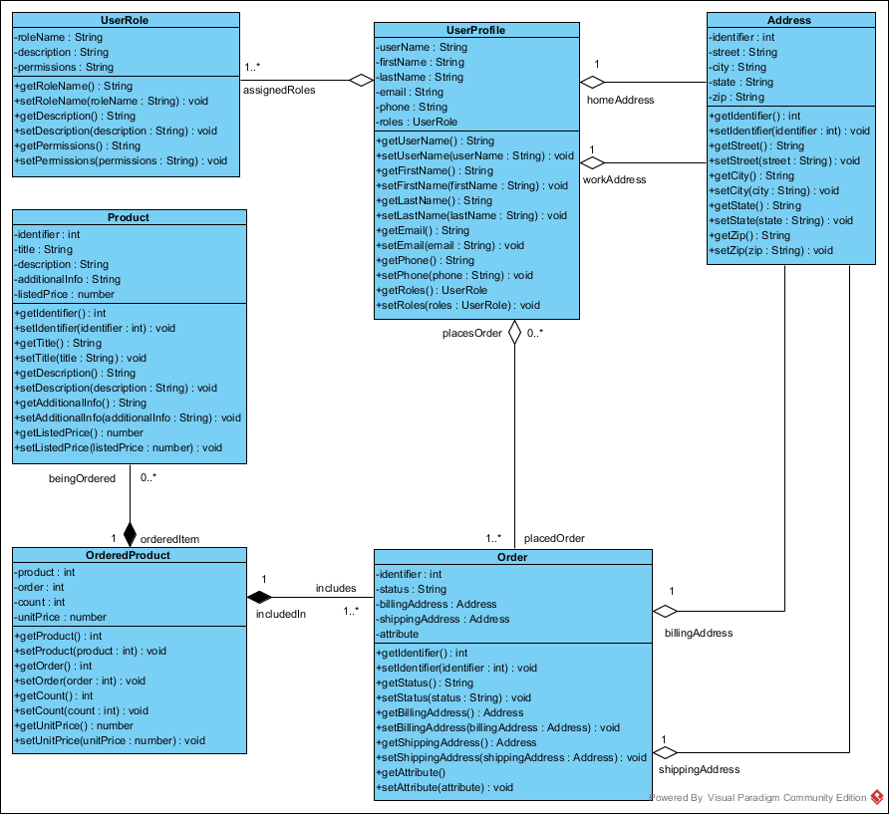
Minimal Class Diagram
Figure-CD#133: Class diagram of Backend support for user registration
Notes:
10 seconds.Minimal class diagram. Highlight the classes that you created/modified
Identify the design patterns used (one or more slides).

Slide 16
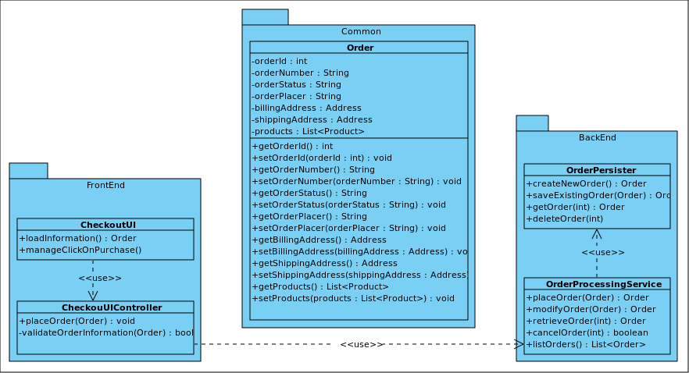
Minimal Class Diagram
Figure-CD#135: Class diagram of OrderService subsystem

Slide 17
User Stories
1. User Story # 124 - Show Product Details
2. User Story # 125 - Show Terms and Conditions
3. User Story # 126 - User Registration
4. User Story # 133 - Backend Support for User Registration
5. User Story # 134- Backend Support for Product
6. User Story # 135- Backend Support for Order Processing
7. User Story # 157 - Management Console
Notes:
5 seconds.
List the user stories that you worked on them.(put in order of importance). Stay focused on the parts that you have been working.

Slide 18
1.User Story 124 - Show Product Details
Tasks
Design and integrate a view for showing product details
Establish architecture or convention for the entry point
Acceptance Criteria
User is already registered
User must accept the Terms and Conditions
Modeling
Refer to UML diagrams in Appendix A: Figure-UCD#124 Show Product Details, & Figure-SD#124: Sequence diagram of Show product details
Notes:
60 seconds
The tile of user story
The most important user story you worked on it. You have to describe this one very well and be proud of that.
Please present and show the complexity of your work, code, algorithms, and technical challenges and technologies you have used. (you could use screenshot if you want. Visual presentations are better than text presentation)
Go into the details of the most important/significant tasks using bullet lists or visual graphs or state chart diagram
Sequence Diagram for this user story is mandatory (in another separate page if required)
Demo using screenshots or GIF (in another separate page if required)

Slide 19
2.User Story # 125 - Show Terms and Conditions
Tasks
Add a menu item to show Terms and Conditions
Design a view and its controller for presenting Terms and Conditions
Acceptance Criteria
For the first time when a user interacts with an Ad, terms and conditions must be shown to him/her
A user can view the terms and conditions on his/her will.
Modeling
Refer to UML diagrams in Appendix A: Figure-UCD#125: Use case diagram of Terms and Condition
Notes:
20 seconds
The tile of user story
Please present and show the complexity of your work, code, algorithms, and technical challenges and technologies you have used. (you could use screenshot if you want. Visual presentations are better than text presentation) - Go into the details of the most important/significant tasks using bullet lists or visual graphs or state chart diagram - Demo using screenshots or GIF (in another separate page if required)
Sequence Diagram for this user story is optional

Slide 20
3. User Story # 126 - User Registration
Tasks
Design a view and its controller for registration module for the user
Acceptance Criteria
If the user is not registered already
Modeling
Refer to UML diagrams in Appendix A: Figure-UCD#126, Use case diagram for user registration, & Figure-SD#126: Sequence diagram of User Registration
Notes:
20 seconds
The tile of user story
Please present and show the complexity of your work, code, algorithms, and technical challenges and technologies you have used. (you could use screenshot if you want. Visual presentations are better than text presentation) - Go into the details of the most important/significant tasks using bullet lists or visual graphs or state chart diagram - Demo using screenshots or GIF (in another separate page if required)
Sequence Diagram for this user story is optional

Slide 21
4. User Story # 133 – Backend Support for User Registration
Tasks
Establish the initial architecture of the backend component
Design database
Design and implement ORM model
Design and implement an API to access user information
Design and implement a controller for user management
Integrate user registration from client side
Acceptance Criteria
The user information is stored in a remote persistent storage
The user can have a way to access old profiles on a new device
Notes:
20 seconds
The tile of user story
Please present and show the complexity of your work, code, algorithms, and technical challenges and technologies you have used. (you could use screenshot if you want. Visual presentations are better than text presentation) - Go into the details of the most important/significant tasks using bullet lists or visual graphs or state chart diagram - Demo using screenshots or GIF (in another separate page if required)
Sequence Diagram for this user story is optional

Slide 22
4. User Story # 133 – Backend Support for User Registration Con’t
The user information can be updated
User information can be removed from the system
A list of user profiles can retrieved
Modeling
Refer to UML diagrams in Appendix A: Static UML Diagrams, Figure-CD#133 Use case diagram for user registration, & Figure-SD#133: Sequence diagram of Backend support for user registration.

Slide 23
5. User Story # 134- Backend Support for Product
Tasks
Add necessary relational objects
Add necessary API for product management
Add a corresponding DAO in Data Access layer
Add a corresponding Web service Resource object in service layer
Acceptance Criteria
A new product can be created through the service
An existing product information can be retrieved
An existing product information can be updated
An existing product can be deleted from the system
A list of products can be retrieved
Modeling
Refer to UML diagrams in Appendix A Figure-UCD#134 Use case diagram for product management
Notes:
20 seconds
The tile of user story
Please present and show the complexity of your work, code, algorithms, and technical challenges and technologies you have used. (you could use screenshot if you want. Visual presentations are better than text presentation) - Go into the details of the most important/significant tasks using bullet lists or visual graphs or state chart diagram - Demo using screenshots or GIF (in another separate page if required)
Sequence Diagram for this user story is optional

Slide 24
6. User Story # 135- Backend Support for Order Processing
Tasks
Add service layer for order management
Implement data access layer for order management
Add API for order management
Create entities and mapping objects
Acceptance Criteria
The backend system has capability to create, modify, retrieve and cancel orders
After creating an order the systems provides necessary information for next steps
User must accept the Terms and Conditions
Modeling
Refer to UML diagrams in Appendix A: Figure-UCD#135: Use case diagram of the OrderService subsystem, Figure-CD#135: Class diagram of OrderService subsystem, & Figure-SD#135: Sequence diagram of OrderService subsystem

Slide 25
7. User Story # 157 - Management Console
Tasks
Add backend support to list the objects
Add a view to list the users
Add a view to create and modify product
Add a view to list the products
Add a view to list orders
Acceptance Criteria
A visual console to manage the entities of the system is implemented
Access is restricted to that console

Slide 26
Test Suites and Test Cases
Unit Tests
User Story # 124 - Show Product Details
Test ID: U-124-01
Purpose: To validate that the terms and conditions must be accepted before using the app.
Preconditions: The application is run for the first time.
Input: None
Expected Output: The view for presenting the terms and conditions page is chosen to show
Notes:
10 seconds
A description of verification process and Test Suites and Test Cases for one of the use cases.
1 One sunny day and one rainy day for the implemented use cases (one or more slides).
2 Automated test scripts for the implemented use cases (if any) (one or more slides).

Slide 27
Test Suites and Test Cases Con’t
User Story # 124 - Show Product Details
Unit Tests
Test ID: U-124-02
Purpose: To validate that the system displays the user registration page if not registered yet before presenting the product details.
Preconditions: The user has not been registered yet.
Input: None
Expected Output: The view for user registration is chosen to present

Slide 28
Test Suites and Test Cases Con’t
User Story # 126 - User Registration
Unit Test
Test ID: U-126-01
Purpose: To test that the application accepts valid input as username
Preconditions: None
Input: try to create a user with following information {"username":"","firstname":"First","lastname":"Last","email":"first_last@example.com","phone":"+18888888"}
Expected Output: The application should show a failure message showing that the username is missing No request should be made to server to create a user.

Slide 29
Test Suites and Test Cases Con’t
User Story # 126 - User Registration
Unit Test
Test ID: U-126-2
Purpose: Assure that a user cannot be created if the user exists in database.
Preconditions: System must be functional and a user with username “example1” exists and the server can detect the existence and reports accordingly.
Input: New user creation request is made with the following information: {"username":"example1","firstname":"First","lastname":"Last","email":"first_last@example.com","phone":"+18888888"}
Expected Output: A request is made to server to create the userprofile The application should detect and understand the reason of failure Shows an error message that the username “example1” is already used.

Slide 30
Test Suites and Test Cases Con’t
User Story # 133 - Backend Support for User Registration
Unit Test
Test ID: U-133-1
Purpose: To test that a user is created only if the username is valid
Preconditions: None
Input: A request is made to create a user with the following data {"username":"","firstname":"First","lastname":"Last","email":"first_last@example.com","phone":"+18888888"}
Expected Output: The system raises an invalid username exception and send error status.

Slide 31
Test Suites and Test Cases Con’t
User Story # 133 - Backend Support for User Registration
Integration Test
Test ID: I-133-1
Purpose: To test that a user profile will be created only with a non-existing “username”.
Preconditions: A user with username “example1” exists
Input: A request is made to create a new user with the following data: {"username":"example1","firstname":"First","lastname":"Last","email":"first_last@example.com","phone":"+18888888"}
Expected Output: The system tries to save/insert user information The database raises a duplicate entry exception The system should detect the exception and send failure response accordingly with proper error message.

Slide 32
Test Suites and Test Cases Con’t
User Story # 135- Backend Support for Order Processing
Unit Test
Test ID: U-135-1
Purpose: To test if the system fails to create an order without the username of the user who actually is placing the order
Preconditions: All other information are present and valid
Input: Try to create an order not mentioning any username.
Expected Output: The system fails to create an order entity by raising an exception mentioning that no valid username is provided as order placer

Slide 33
Test Suites and Test Cases Con’t
User Story # 135- Backend Support for Order Processing
Integration Test
Test ID: I-135-1
Purpose: To test if the system fails to place an order when non existent username is mentioned as order placer
Preconditions: The user with username “example_9” is not present and all other information are present and valid.
Input: Make a request to place an order with the following data {"username":"example_9", "billingAddress":{"addressId":11, "addressLineOne":"10274 SW 102 Ave suit 201", "city":"Miami", "state":"FL", "zipCode":"33178"}, "shippingAddress":{"addressId":12, "addressLineOne":"10274 SW 103 Ave suit 202", "city":"Miami", "state":"FL", "zipCode":"33178"}, "products":[{"productId":34,"unitPrice":9.94,"count":5}]}
Expected Output: The system fails with the exception that no registered user found having username “example_9”.

Slide 34
Wishlist/Shortcomings
Backend Support for Logistic
Process payment
Communication from android application to the server
Order placement from phone
Pushing the ads from ADUPS environment

Slide 35
Summary
The phone shopping network will provide new opportunities for both the end users and the service providers.
The end users i.e. the low income families can be able to get great offers of savings.
At the same time the service providers of the life line program can be able to generate revenue from the phones that remain not useful.
It also helps build credit of the user
Notes:
10 seconds
Summarize your contribution, mention your effort for Scrum, Mingle, Github, Google Drive Documentation and minutes
Include your contact information
Ask if anyone has any questions for you.
Thank your audience

Slide 36
contact information
Name: Khaja Mohammed
Email: kmoha023@fiu.edu
Name: Dewan Moksedul
Email: dalam004@fiu.edu

Slide 37
Questions ?

Slide 38
Thank You!

Slide 39








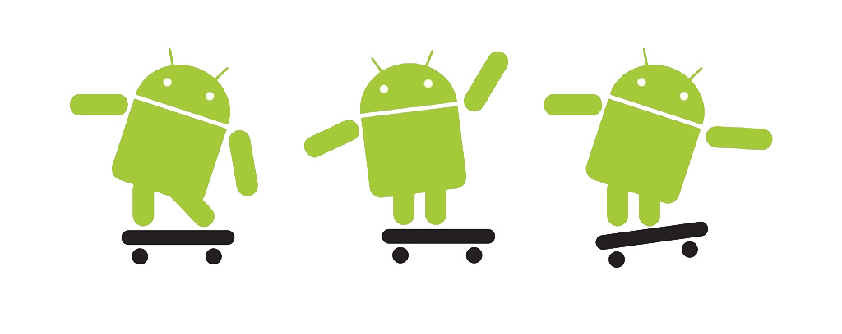





References
Spring Framework (Version 4.3.3.RELEASE). https://projects.spring.io/spring-framework/
Jersey-RESTful web services in Java Version 2.23.2. https://jersey.java.net/
Hibernate Version 5.2.3.final. http://hibernate.org/orm/
Commons-DBCP version 1.4. https://commons.apache.org/proper/commons-dbcp/
MySQL JDBC Connector Version 5.1.31. https://www.mysql.com/products/connector/
Jackson JSON API for java Version 2.5.4. http://wiki.fasterxml.com/JacksonHome
Bootstrap Version 3.3.7. http://getbootstrap.com/
JQuery Version 3.1.1. https://jquery.com/
KnockoutJS Version 3.3.0. http://knockoutjs.com/

